Slide 1

CB SAVE THE MUSIC CONCERT
CBSTM: Behind the magic…

Slide 2

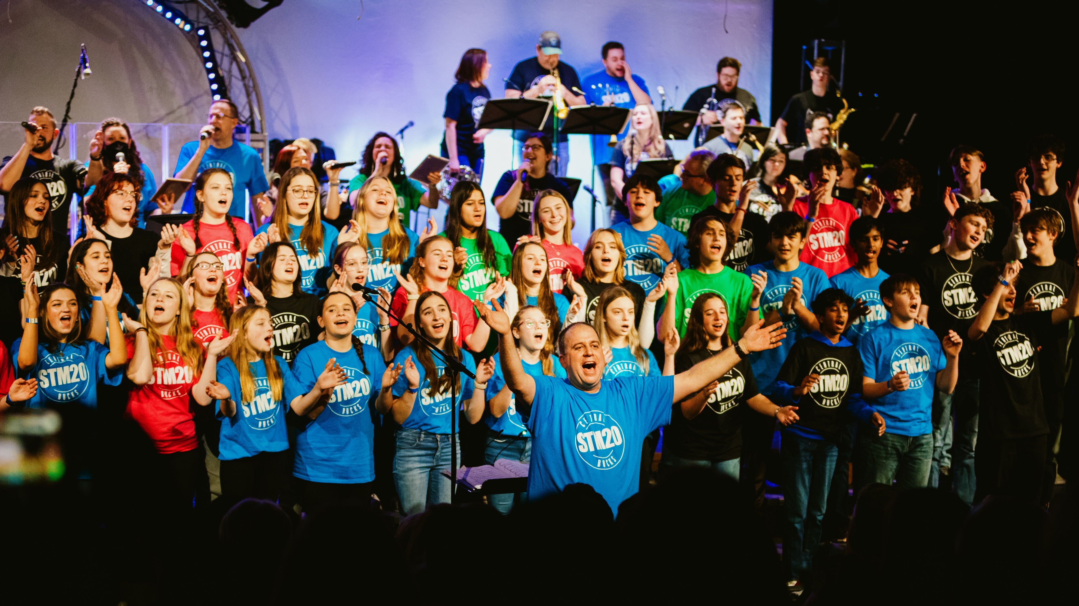
ABOUT THE SHOW
The first concert was held in 2004 and was a 1-night event.
It began as a way for us, as educators, to show our students what could be achieved musically with hard work and practice.
We decided that attaching a charity to the event would draw more community members. The Save The Music Foundation was a natural fit.
The show has grown to become a 2-day/3-concert event that sells out the Holicong auditorium for every show.

Slide 3

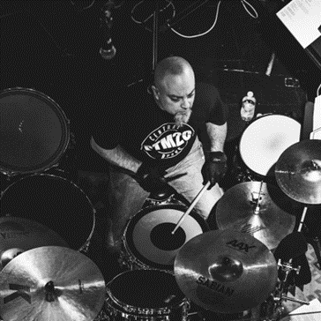
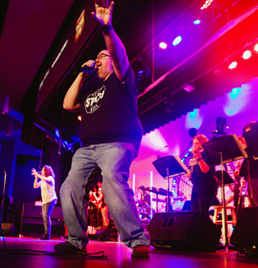
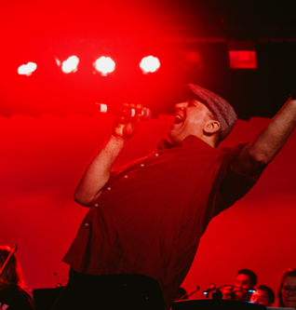
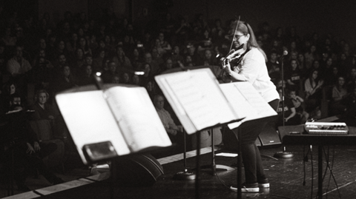
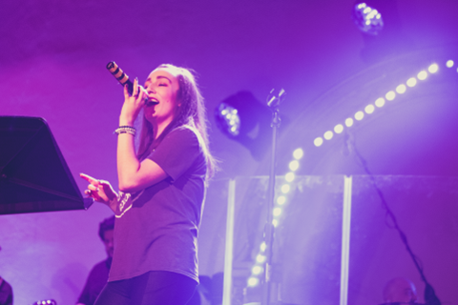
The CBSTM Concerts are organized and put together by a 5-person team. They are:
Joel Chodoroff: Holicong Band Director
Jim Glaser: Holicong Choir Director
Jennifer Repper: Holicong Orchestra Director
Amanda Romig: Holicong Special Education Teacher
Ian Sanchez: Tamanend Choir Director
WHO IS THE CBSTM “BRAIN TRUST??”

Slide 4


CBSTM:
Impact and Outreach
13
$400K
States served nationwide
Donated to-date in Instruments & Equipment
Over 2,000 students nationwide have been able to receive Music Education thanks to the proceeds of this concert.
Our donations have been used in 13 different states across the country, including targeted donations to the following schools: Thurgood Marshall Academy and R.R. Moton Charter School (New Orleans, LA); Luis Munoz Marin Elementary School (Newark, NJ), and Amanda Elzy Junior High School (Mississippi Delta Region)

Slide 5
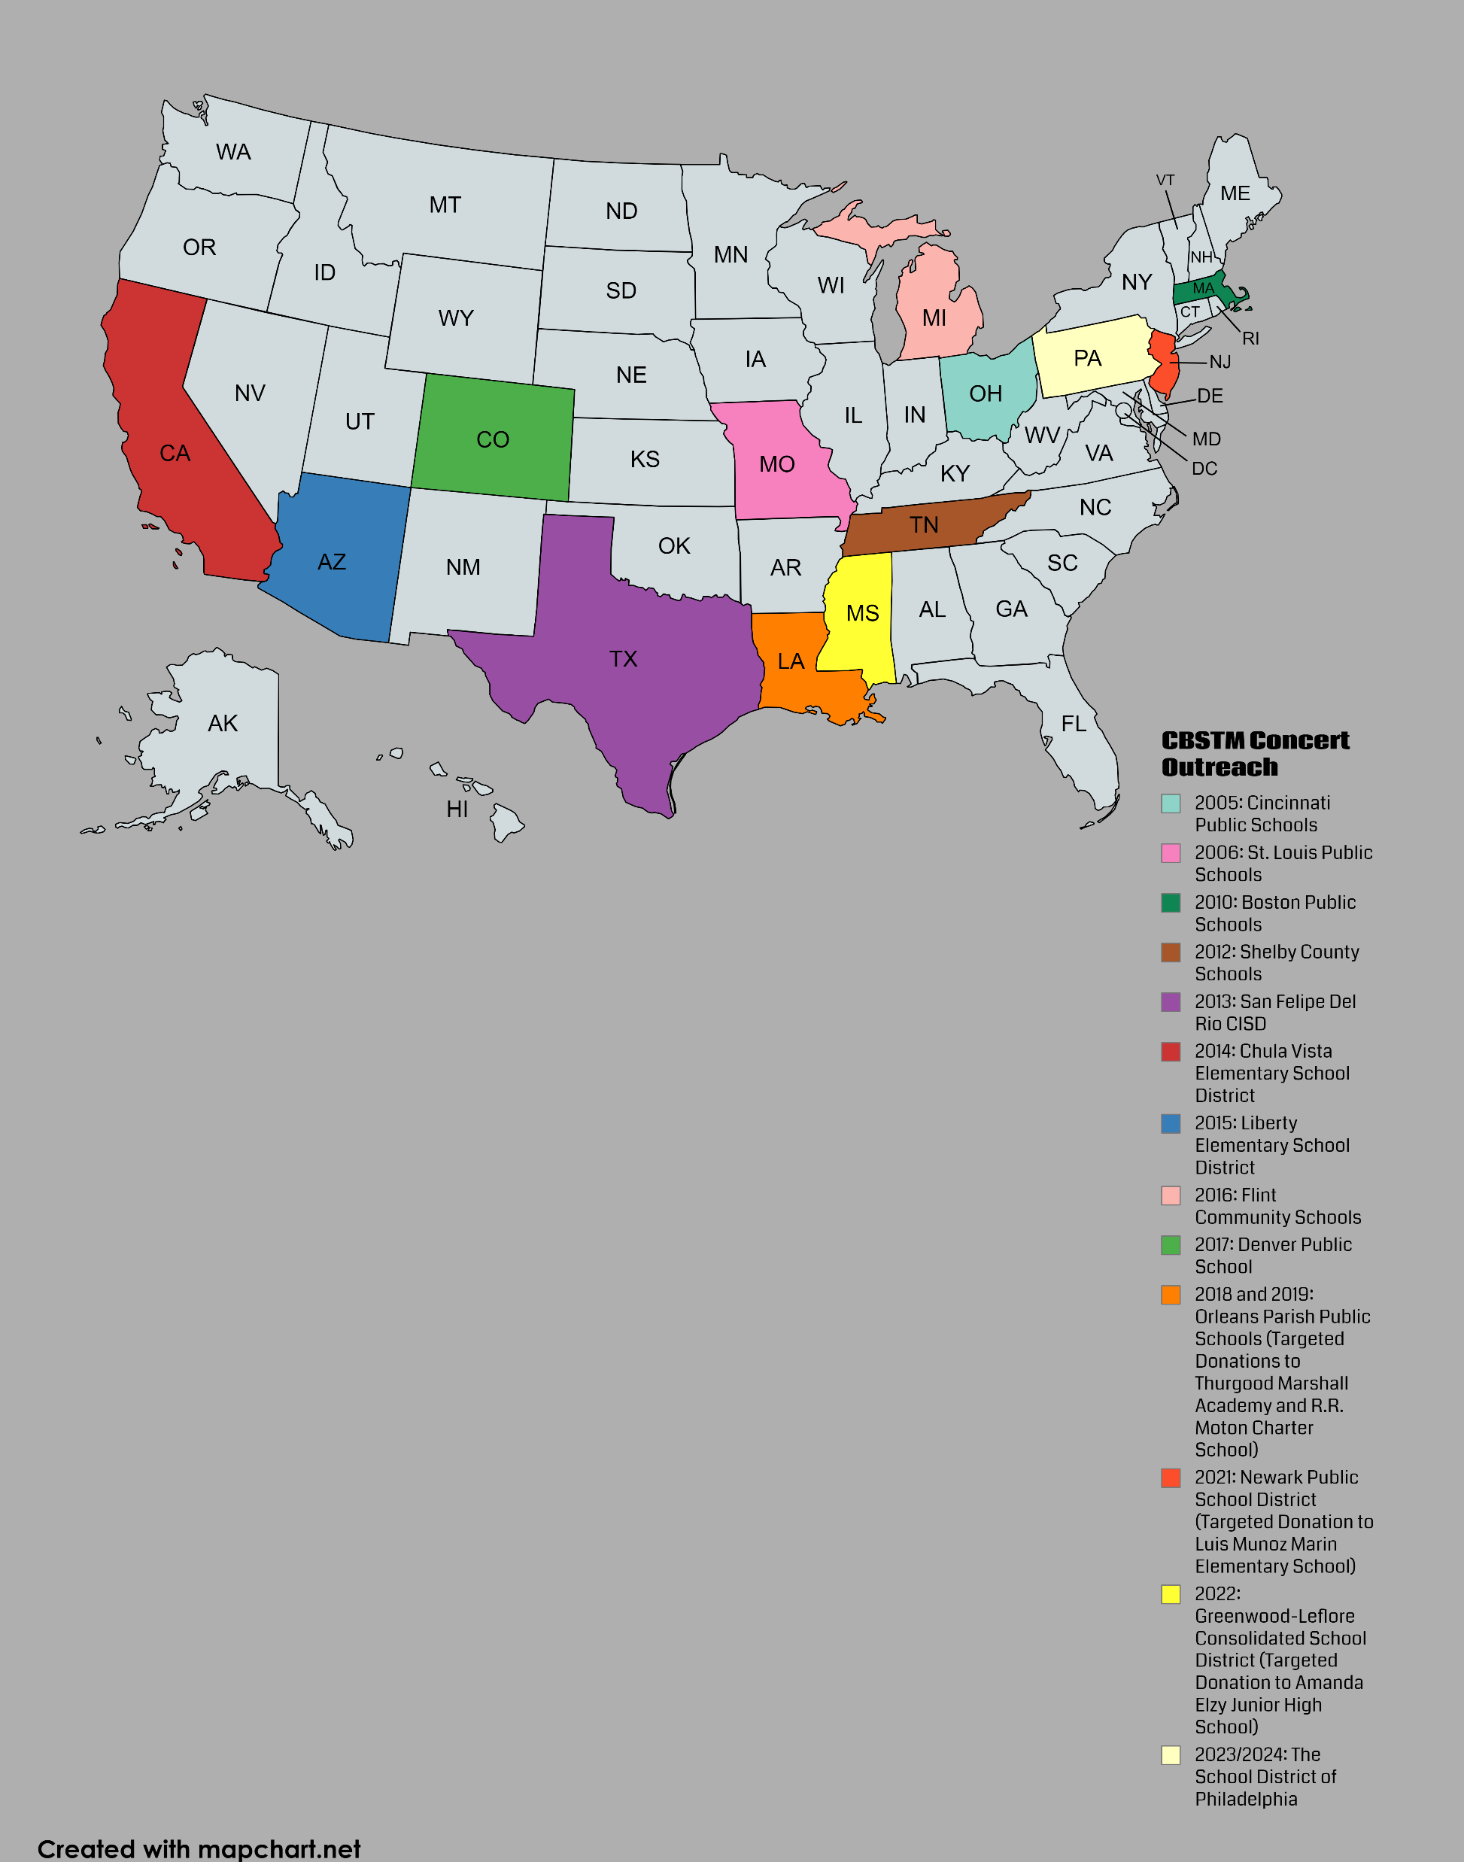
CB Save The Music: Donation Recipients

Slide 6
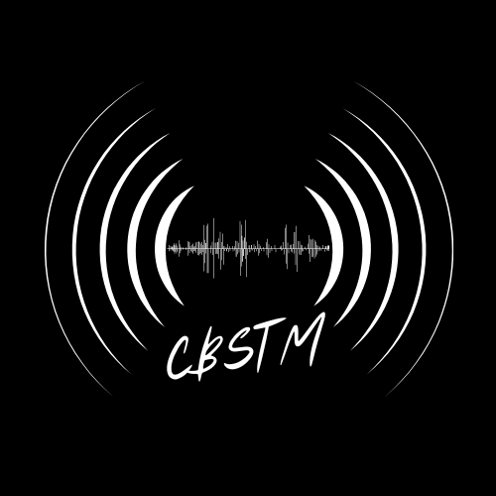


CBSTM In-District Impact
Part 1: CB Pride and Community Builder
1
2
3
LEADING THE WAY
STUDENT STARS
COMMUNITY ROCKS
Central Bucks is the only school district in the country to put on an event of this magnitude benefitting the Save The Music Foundation. There is, quite literally, nothing else like it in the country (and more than likely the world).
While the main performers are adults (or “pros”), CB students from across the district have helped make the concert event memorable. To date, approximately 3,000 CB students FROM EVERY SCHOOL IN THE DISTRICT have been a part of the concert.
At a time when bringing our community together has never been more important, it should be noted that over 26,000 community members have attended a CB Save The Music Concert. From 2017 on, the event has been a complete sell out (2,400 people/year).

Slide 7
CBSTM In-District Impact
Part 2: Saving The Music Near and Far
The CB Save The Music Concert is proud to announce a new model for our donation. We call it the “90/10.” See below to find out exactly what that means…
90%
90% of the proceeds raised will continue to go to the Save The Music Foundation in an effort to provide students in underprivileged and underfunded areas with a quality music education.
10%
10% of the proceeds raised will “stay home” in the district and go towards providing scholarship instruments for CB students in need. EACH YEAR this donation will put approximately 20 – 30 instruments in the hands of kids who otherwise might not have been able to play.

Slide 8
SPONSORS, DONORS, and PARTNERS
How YOUR business can help save the music

Slide 9

Sponsors, Donors, and Partners:
Sponsors, Donors, and Partners are crucial to our event in so many ways, and we have multiple levels to accommodate businesses of all sizes. What is the difference between the three? We’re glad you asked!!
SPONSOR
DONOR
PARTNER
Becoming a CBSTM Sponsor means that your donation is targeted to pay for a specific aspect of the concert.
We currently offer 4 different sponsorship levels.
Becoming a CBSTM Donor means that you are making a general donation to the concert and/or Save The Music Foundation.
We currently offer 5 different donor levels.
Becoming a CBSTM Partner means that you are donating either goods or services, not money, to the CBSTM Concerts.
We currently offer 2 different partner levels.
Please consider joining the team!

Slide 10
CBSTM Sponsorship Opportunities
Orchestration Sponsor ($1,000)
Sound Sponsor ($2,500)
How many: 6 sponsorships available
What it is: Your donation goes directly to paying a professional arranger to orchestrate one of the musical medleys. The medley will be played at least twice during the concert weekend.
What you get:
  30 second commercial in ONE SHOW
  Digital ad in our pre-concert slideshow
  Business name/logo in our social media sponsor collage.
  Dedicated social media post welcoming you as an Orchestration Sponsor of CBSTM (with a link to your social media/website).
  Print ad in patron booklet.
  Business name/logo on the concert t-shirt (which will be worn by performers at all 3 concerts).
  Verbal acknowledgement from the stage either before or after the medley is performed.
  Business name/logo on all PowerPoint slides displayed above the stage during that medley.
How many: 1 sponsorship available
What it is: What would a concert be without great sound? Your donation would pay for the sound equipment and the audio engineer that makes our concert sound incredible.
What you get:
  30 second commercial in TWO SHOWS.
  Digital ad in our pre-concert slideshow
  Business name/logo in our social media sponsor collage.
  Dedicated social media post welcoming you as the Sound Sponsor of CBSTM (with a link to your social media/website).
  Print ad in patron booklet.
  Business name/logo prominently displayed on the concert t-shirt (which will be worn by performers at all 3 concerts).
  Verbal acknowledgement from the stage during all 3 concerts.

Slide 11
CBSTM Sponsorship Opportunities
Lighting Sponsor ($2,500)
Production Sponsor ($5,000)
How many: 1 sponsorship available
What it is: The lighting and Special FX have become a huge part of the CBSTM Concert experience. Your donation would pay for the lights and our tech expert that operates them.
What you get:
  30 second commercial in TWO SHOWS.
  Digital ad in our pre-concert slideshow
  Business name/logo in our social media sponsor collage.
  Dedicated social media post welcoming you as the Lighting Sponsor of CBSTM (with a link to your social media/website).
  Print ad in patron booklet.
  Business name/logo prominently displayed on the concert t-shirt (which will be worn by performers at all 3 concerts).
  Verbal acknowledgement from the stage during all 3 concerts.
How many: 1 sponsorship available
What it is: Want to go the extra mile and take care of BOTH the lighting and the sound for the CBSTM concert? This is for you!
What you get:
  30 second commercial in ALL 3 SHOWS.
  Digital ad in our pre-concert slideshow
  Business name/logo in our social media sponsor collage.
  Dedicated social media post welcoming you as the Production Sponsor of CBSTM (with a link to your social media/website).
  Print ad in patron booklet.
  Business name/logo prominently displayed on the concert t-shirt (which will be worn by performers at all 3 concerts).
  Verbal acknowledgement from the stage during all 3 concerts.
  We can also work with you to figure out other ways that your company/organization could be featured and/or promoted during the event.

Slide 12
$150 OR MORE
SILVER
Digital ad in our pre-concert slideshow (all 3 concerts)
Business logo (or name) in our social media “sponsor collage”
CBSTM Donor Levels
GOLD
$300 OR MORE
All the above PLUS:
A dedicated social media post welcoming you as a Gold Sponsor (with link to your website/social media accounts)
Print ad in patron book distributed at all 3 concerts
PLATINUM
$500 OR MORE
All the above PLUS:
Business name/logo on the concert t-shirt (worn/sold at all 3 concerts)
MULTI-PLATINUM
$750 OR MORE
All the above PLUS:
A shout-out from the stage during all 3 concerts
Business name listed on the CBSTM website

Slide 13



CBSTM Partner Levels
Digital ad in our pre-concert slideshow.
Dedicated social media post welcoming you as a Diamond partner of CBSTM (with a link to your social media/website).
Business logo (or name) in our social media “partner collage.”
Business name/logo on the concert t-shirt (worn by performers at all 3 shows).
Verbal acknowledgement from the stage during all 3 concerts.
Print ad in our patron booklet
Digital ad in our pre-concert slideshow.
Dedicated social media post welcoming you as a Diamond partner of CBSTM (with a link to your social media/website).
Business logo (or name) in our social media “partner collage.”
Verbal acknowledgement from the stage during all 3 concerts.
Print ad in our patron booklet
Dedicated social media post welcoming you as a Diamond partner of CBSTM (with a link to your social media/website).
Business logo (or name) in our social media “partner collage.”
Print ad in our patron booklet
Diamond Partner
Ruby
Partner
Emerald Partner
A donation of goods and/or service with a value of $750 or more.
A donation of goods and/or service with a value of $500 or more.
A donation of goods and/or service with a value of $250 or more.

Slide 14
MEET THE CBSTM SUPPORT SQUAD
The following businesses (and families) have helped make the CBSTM Concert Experience possible with their support and generosity:
Café with Soul (the CBSTM Presenting Sponsor)
The Davison Family and The UHG Foundation
Bucks County Symphony Orchestra
Malmark Bellcraftsmen
Maney Digital
Peddler’s Village
MRA Group
PRM Services
Impact Advisor’s Group
Anne O’Day Orthodontics
Monkey’s Uncle
Mike Hutkin Window Coverings
CAPS (Council for the Advancement of Public Schools)
Mathnasium of Doylestown
Repko Law, LLC
Fred Beans
Macie Publishing Company
School of Rock, Doylestown
Sarah Cornwell Jewelry
Conco Oil
Cecilia Markham, DMD
Russo Music
Hendrixson’s Furniture
Fusion Kitchen
Performance Printing
Bauder Audio
Zeo Brothers
Starlite
Main Lighting
Accent Event Group
Keen Compressed Gas
Pizza Village
Special FX Rentals
Action Karate, Doylestown
Summerwood
Sheila Wilson Coldwell Banker
True Believers Barber Shop
Randazzo’s Pizza
Mayo Tile
Wycombe Wine
Pretty Bird Coffee
Allora Gifts
East West Gifts
Forward College Counseling
Empanada Mama
Siren Records
UPS Store (Warminster)
Brad Ogden
George’s Music

Slide 15

ABOUT THE
SAVE THE MUSIC FOUNDATION

Slide 16
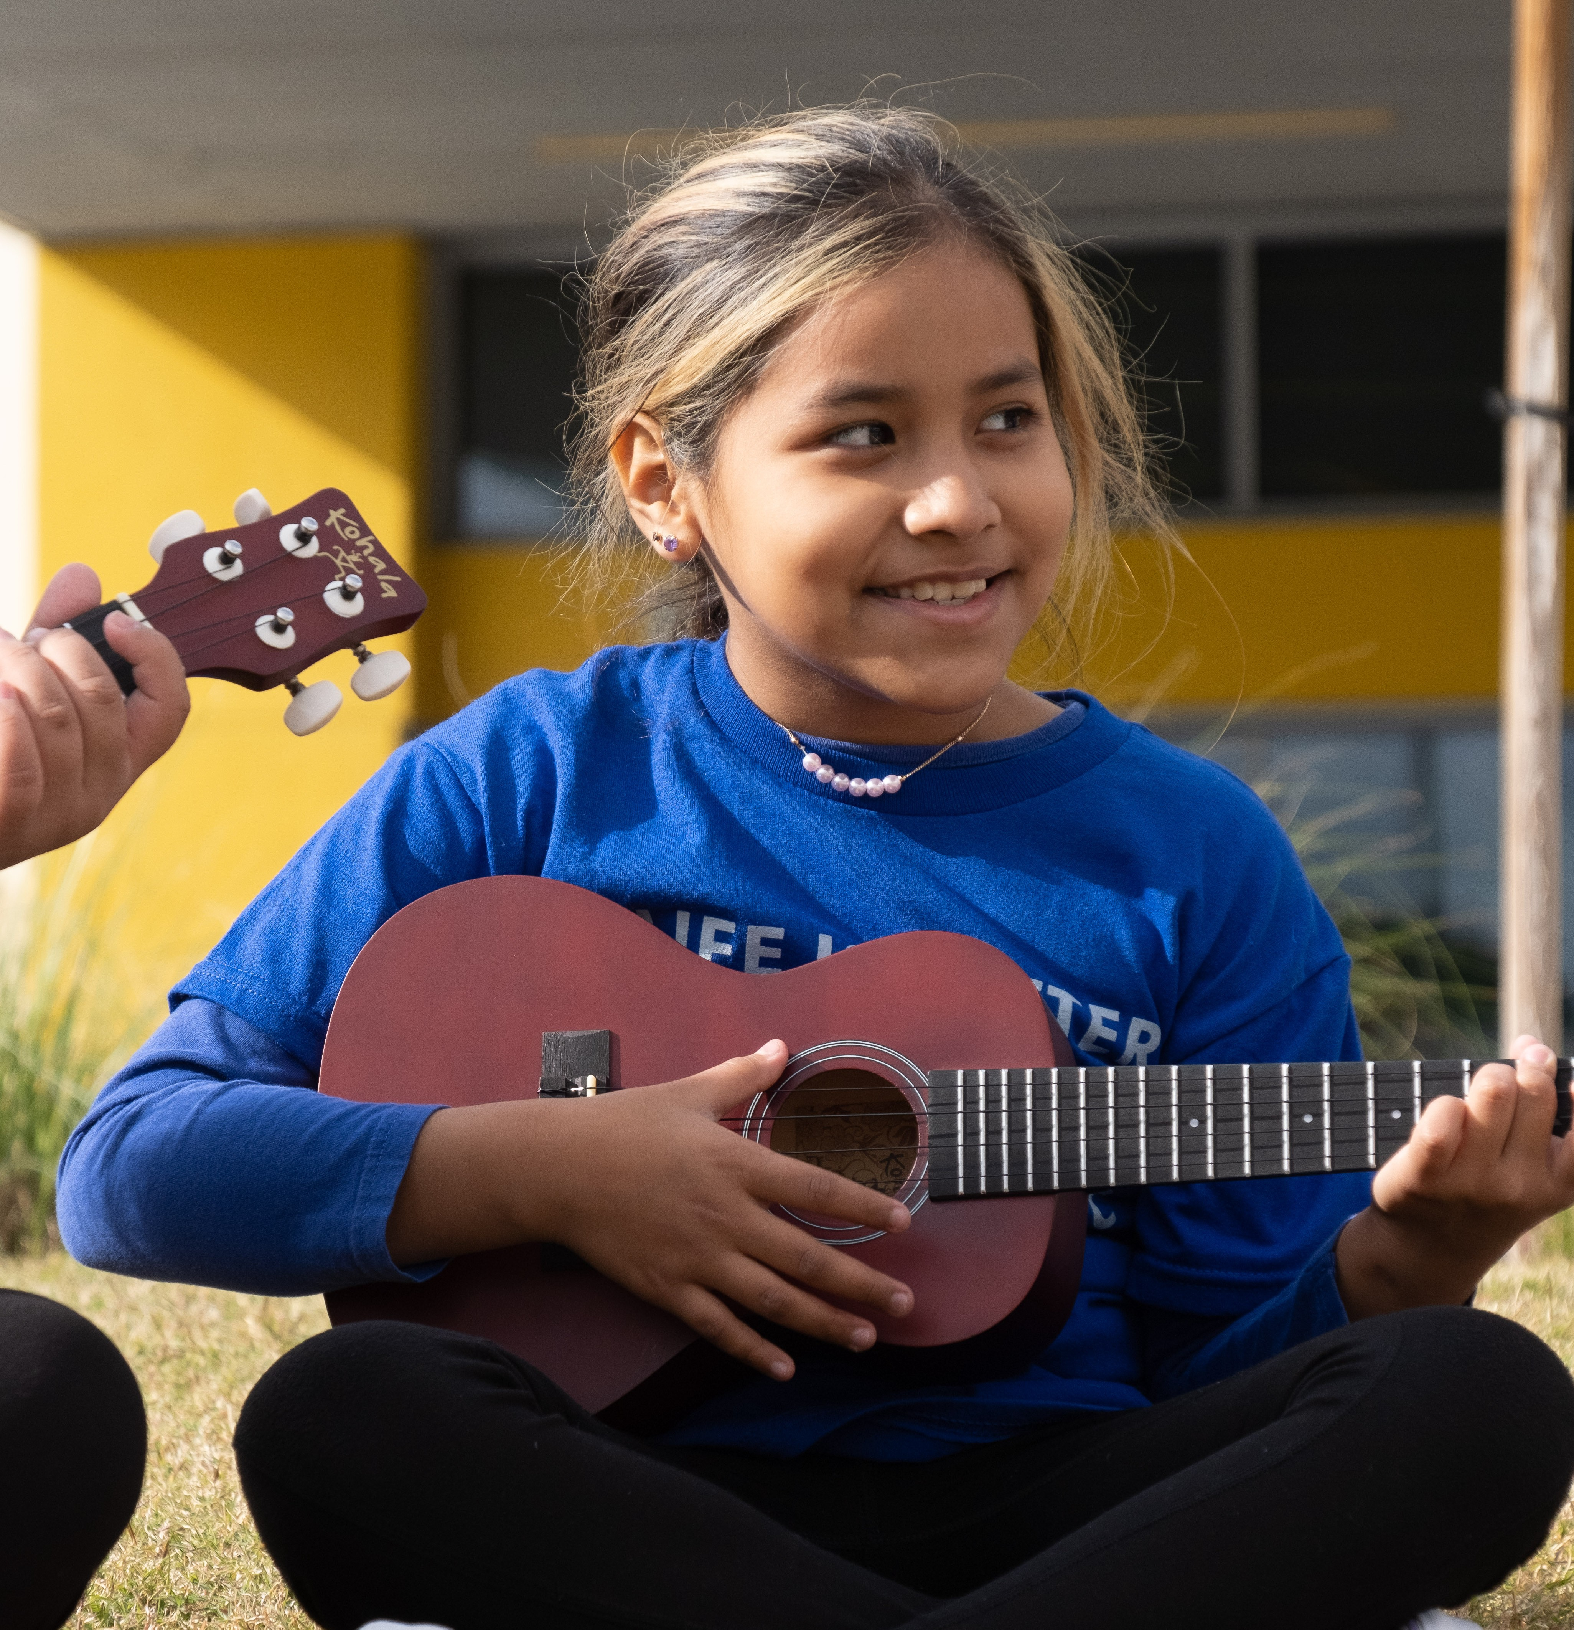

SAVE THE MUSIC
FOUNDATION IS:
A 501(c)(3) nonprofit that helps students, schools, and communities reach their full potential through the power of making music.
For 25 years, Save The Music has addressed the systemic inequities in music education by investing in culturally rich communities across the US. Since its inception, STM has donated $68M worth of instruments and technology to over 2500 schools – impacting millions of students’ lives in hundreds of communities nationwide.

Slide 17



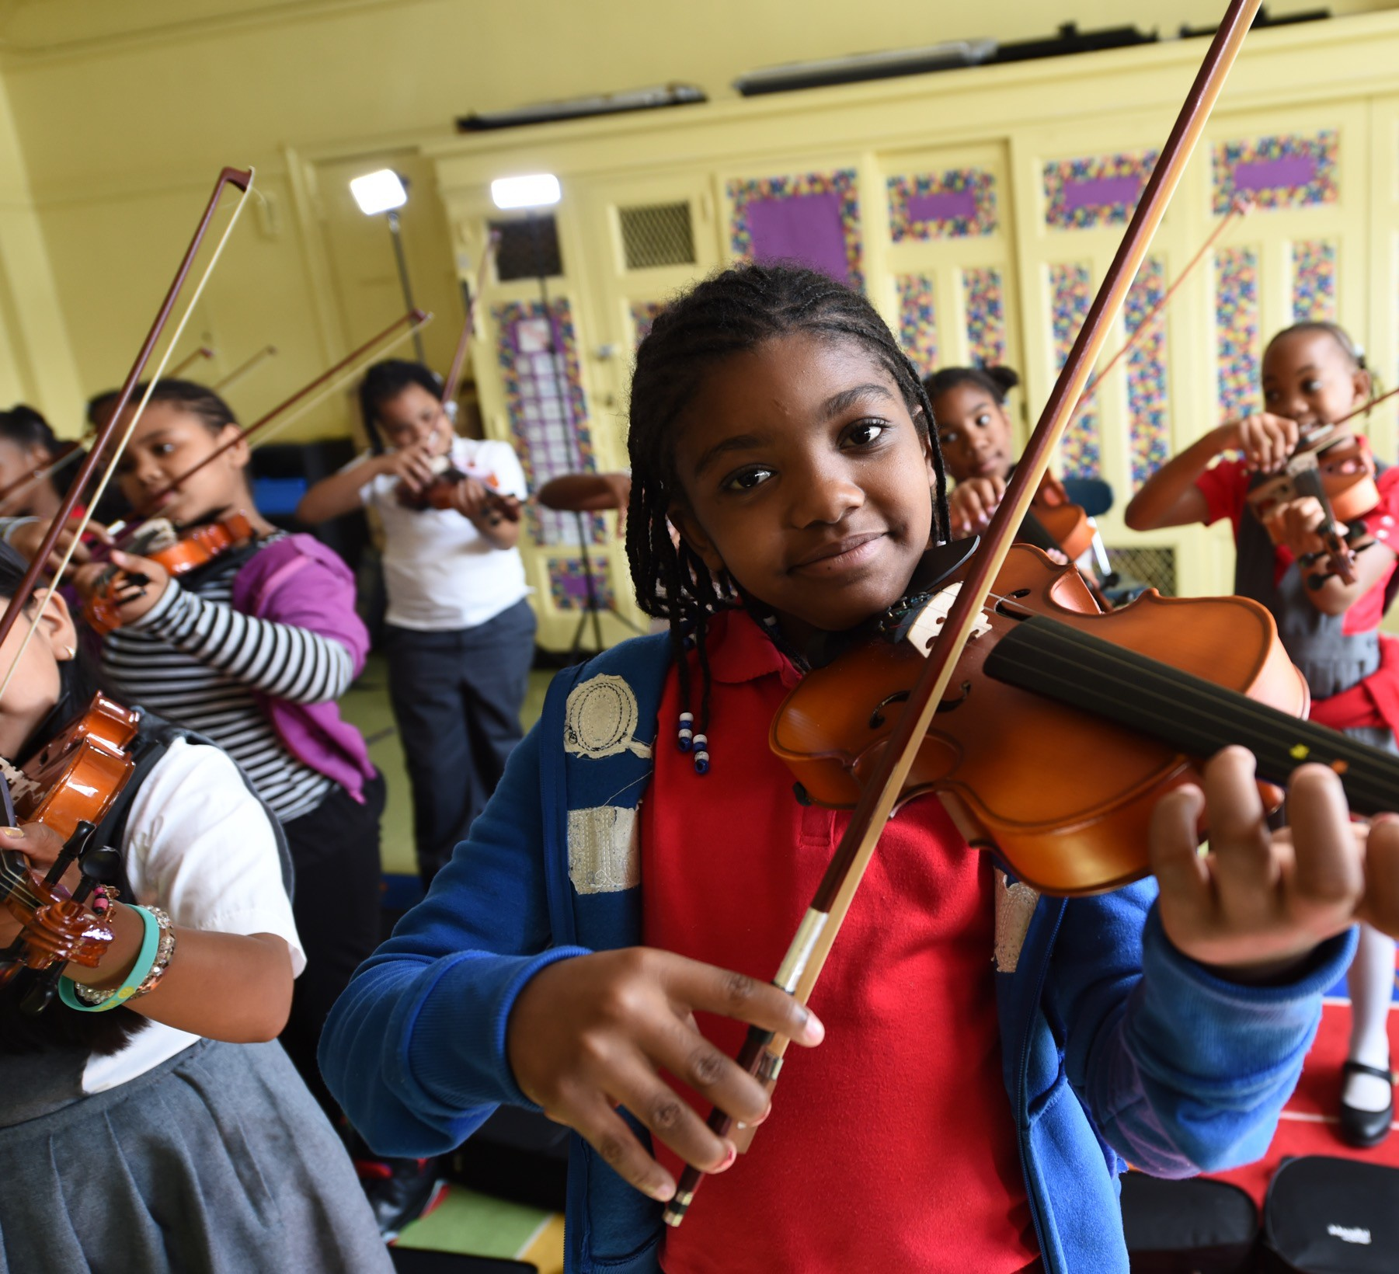
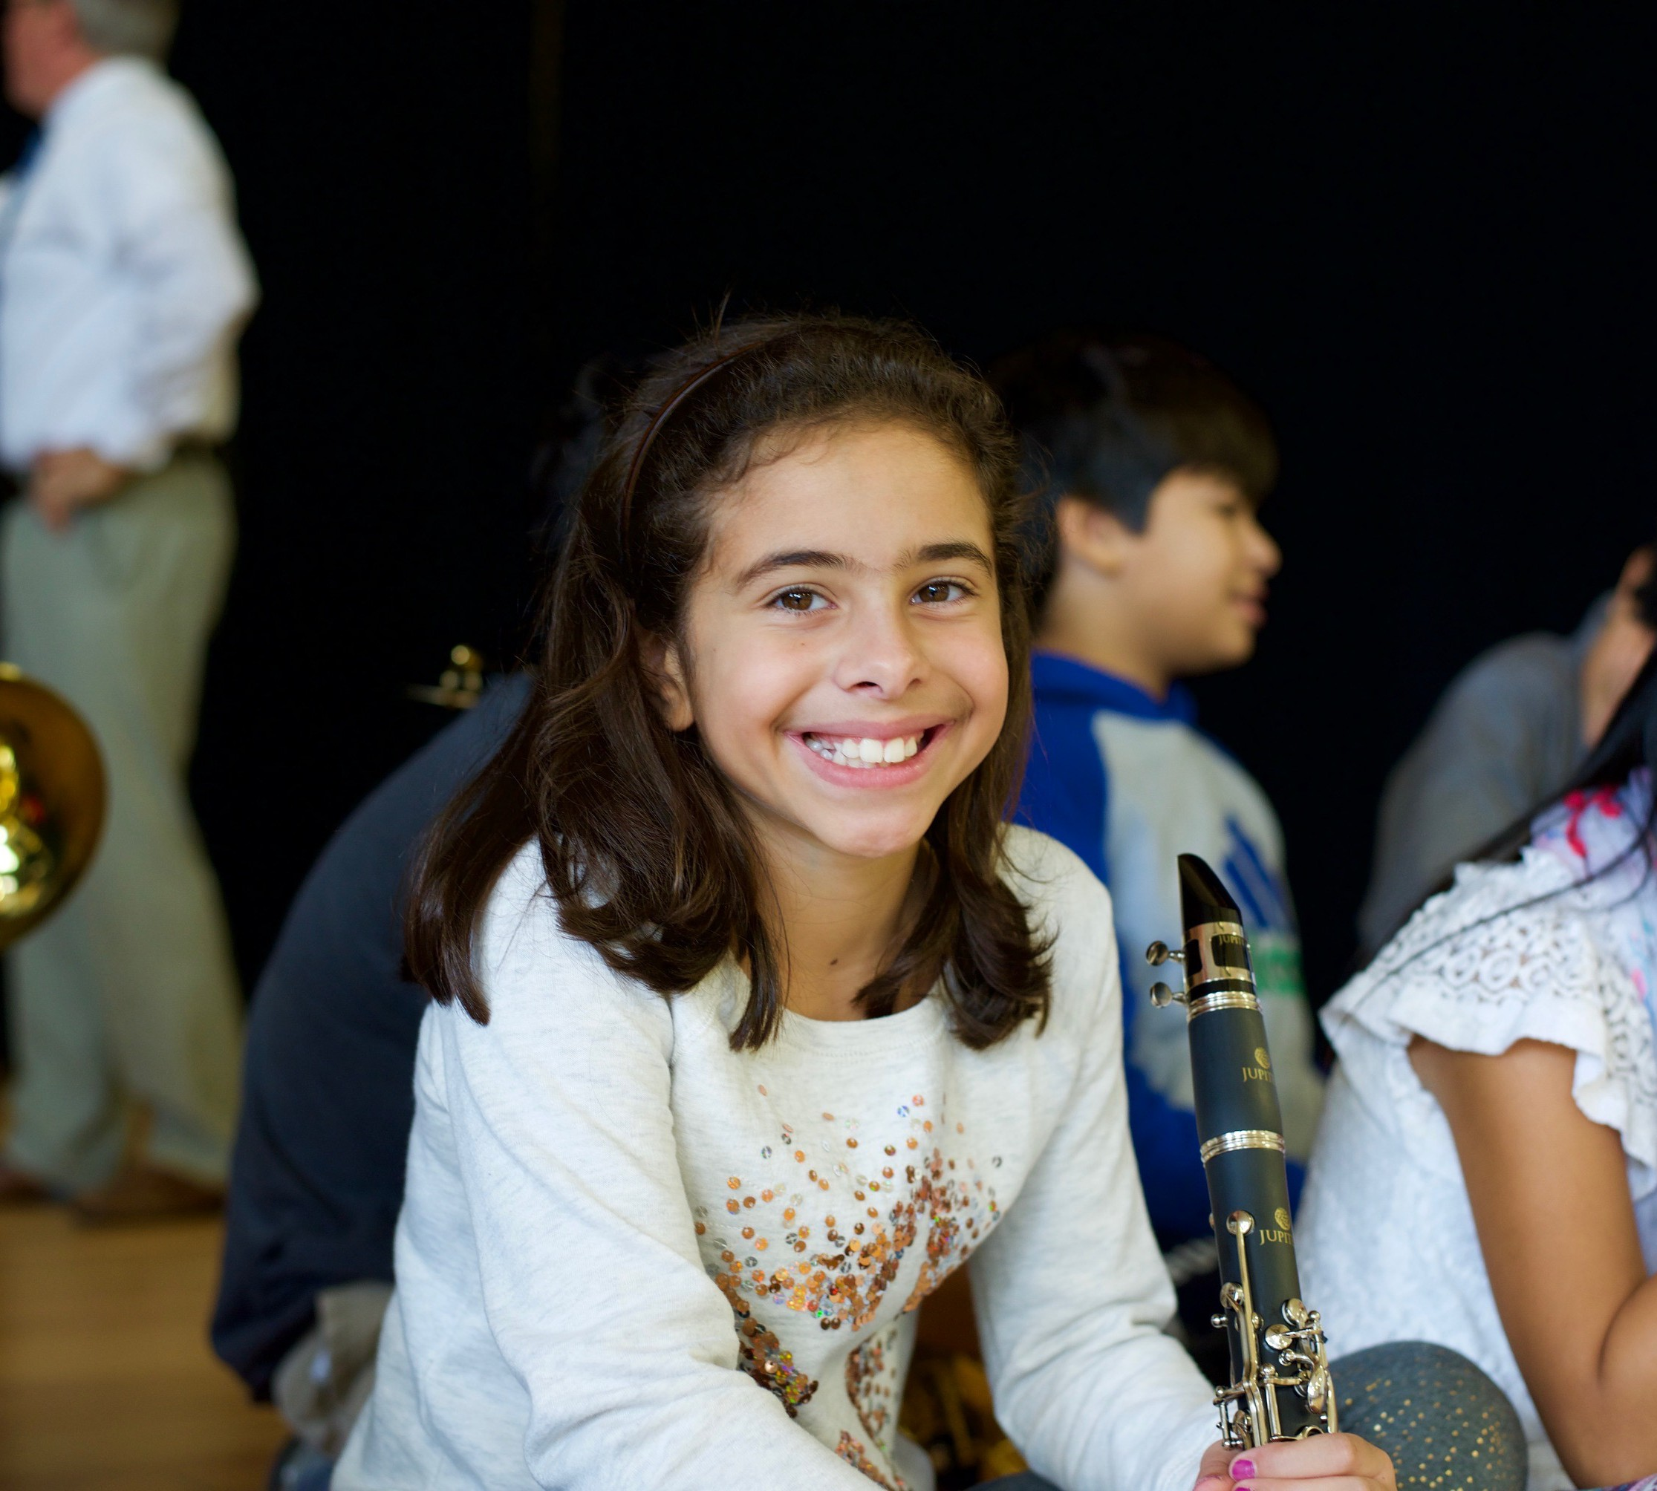
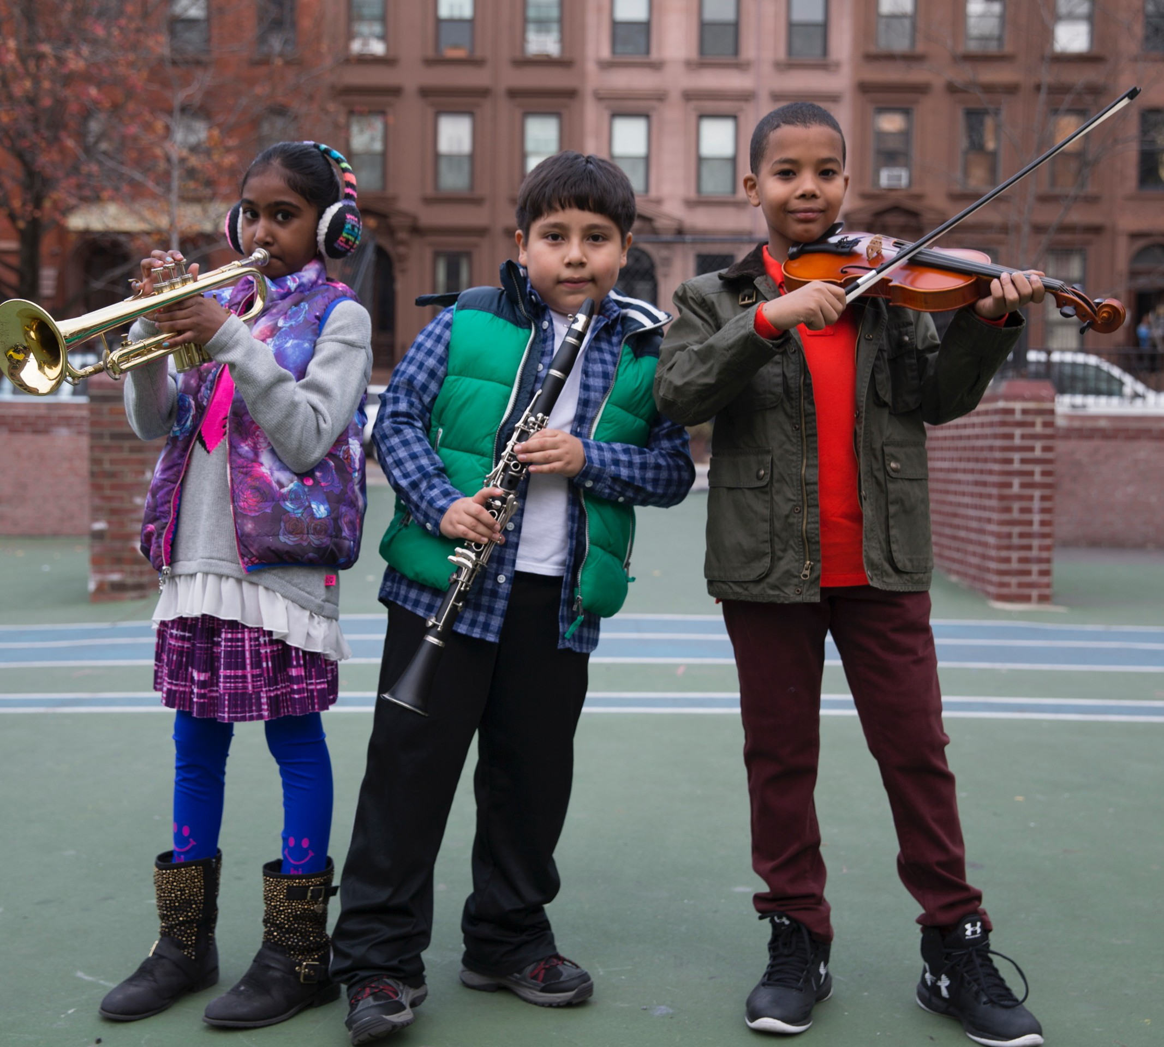
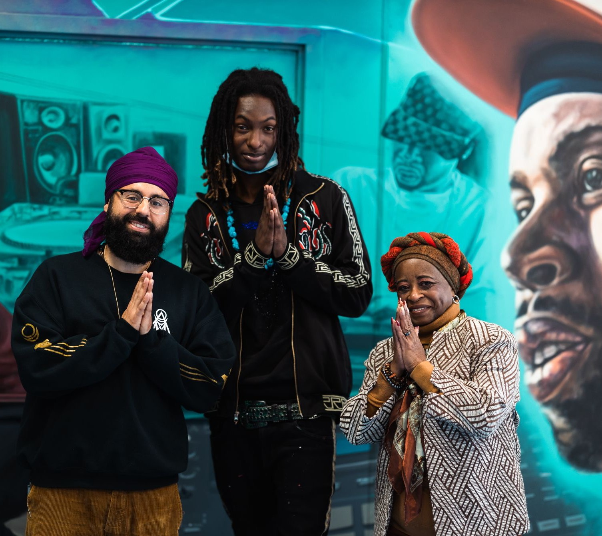
Core Values
STUDENTS
EQUITABLE
COMMUNITY
FIRST
Students are the core of everything we do.
OPPORTUNITY
Ensuring all students have access to music education
IMPACT
The impact of music education extends beyond the classroom

Slide 18







How They Work
INVESTING IN SCHOOLS
SUPPORTING TEACHERS
ADVOCATING FOR MUSIC EDUCATION
INVESTING IN SCHOOLS
Donating instruments, music technology and other
Supporting music teachers with professional development,
At the local, state and national levels to ensure music is part of a well-rounded education.
equipment to jumpstart public school music programs.
ongoing program support and other resources.

Slide 19


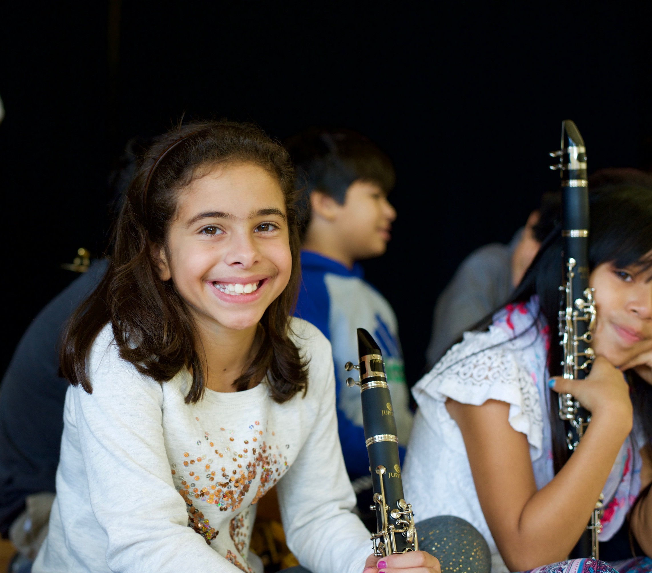
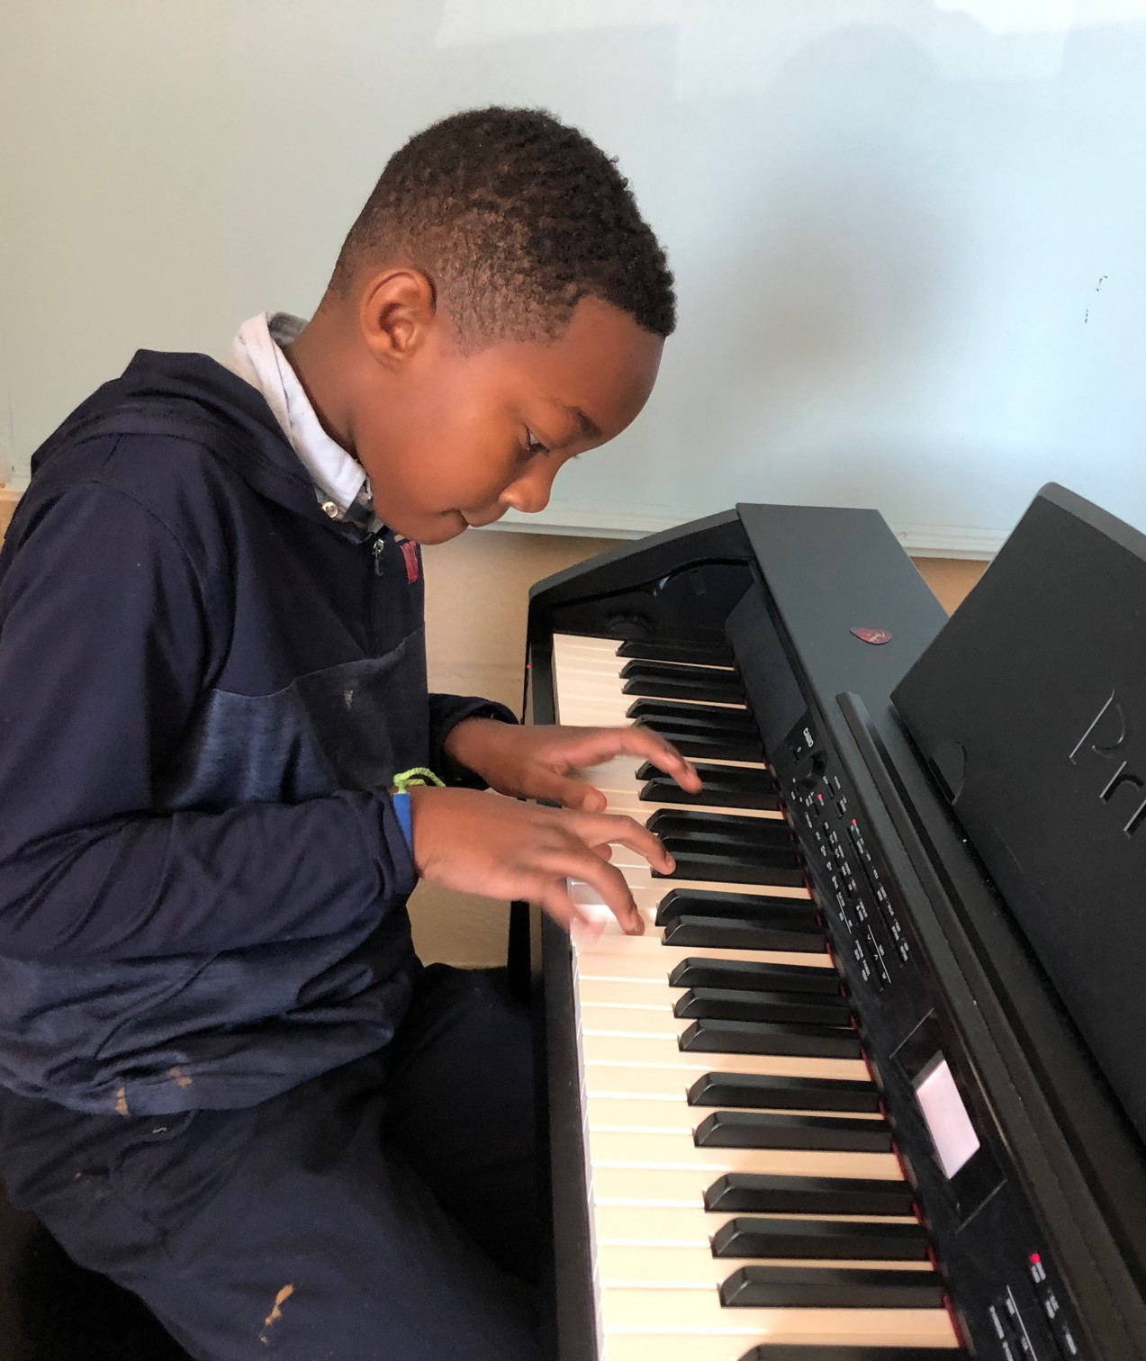
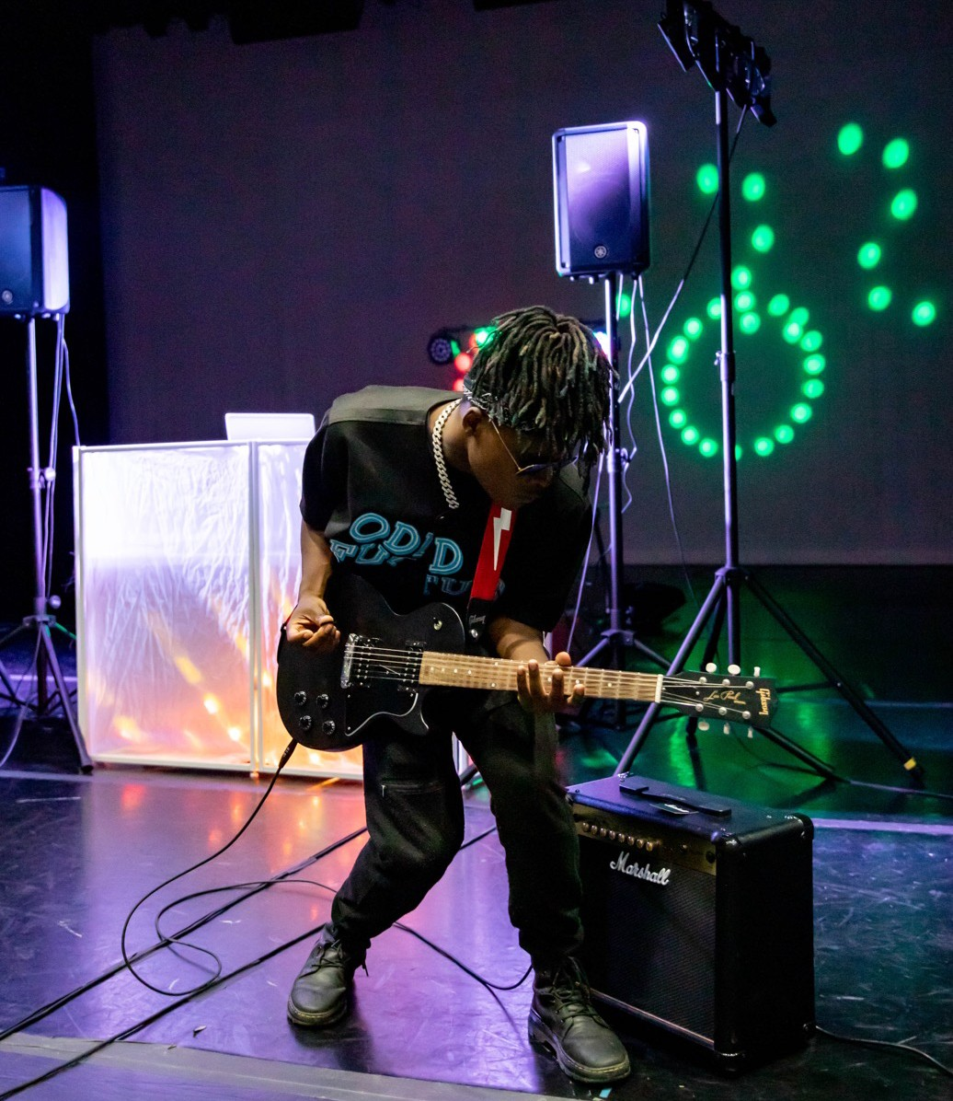

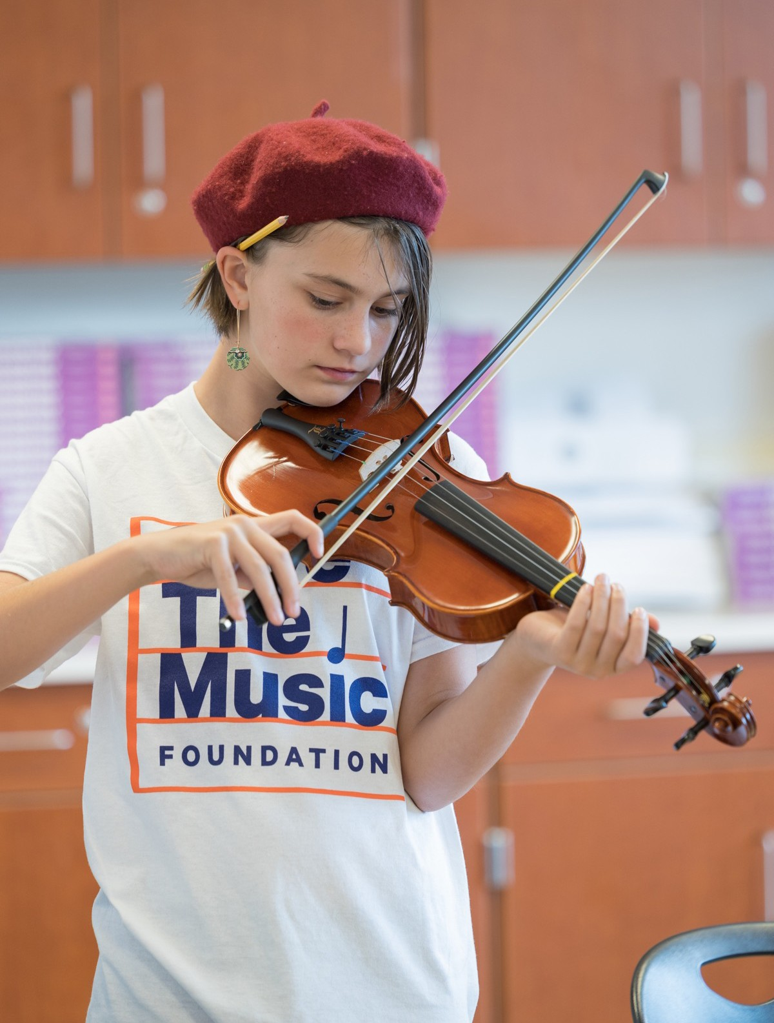

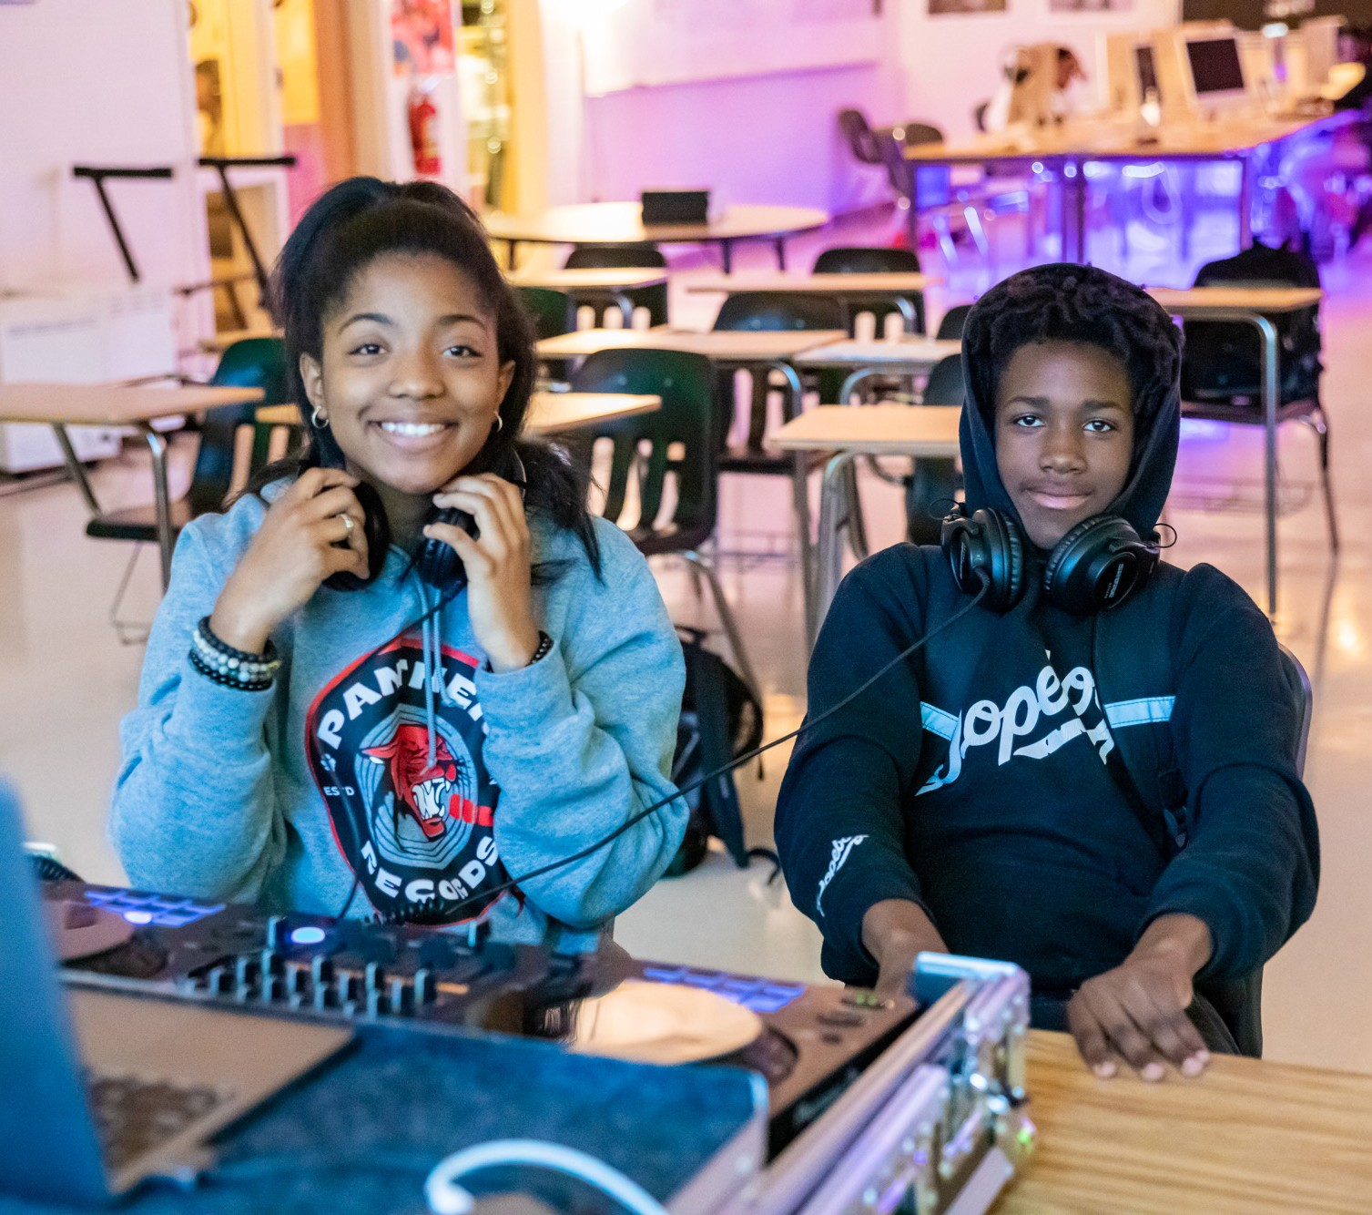


Why Music?
At Save The Music, we invest in public music education so young people have the tools to reach their full potential.
The reality is that almost all affluent and suburban school districts provide music as a core part of their children’s education.
The approximately *4 million public school students who don’t have access to music education attend public schools that largely serve low-income, of color, and immigrant students.
Music education makes a profound impact on children’s academic, social and emotional development – it provides young people with a strong connection to their schools, builds resilience, and gives students a sense of purpose. Decades of research consistently demonstrate music education improves self-discipline, early cognitive development, basic math and reading abilities, self- esteem, teamwork, and school attendance.
Most importantly, by investing in music education, we are connecting students in these communities to a very rich musical and cultural legacy that is rightfully theirs.
*Arts Education Data Project

Slide 20
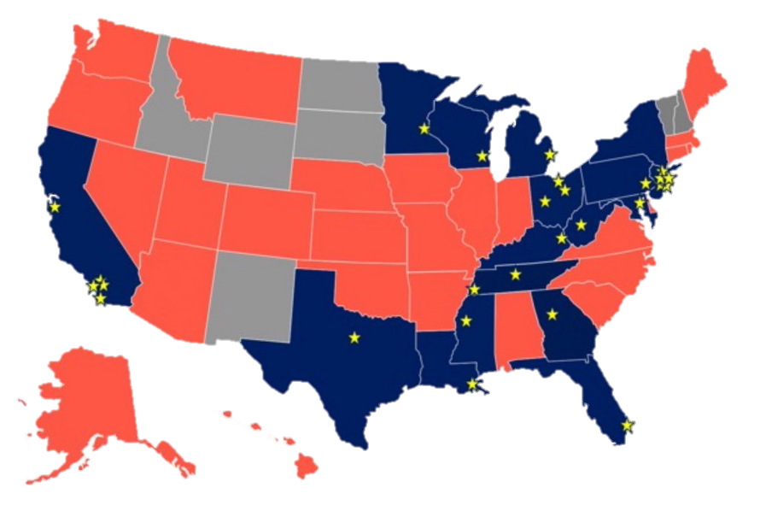

2022 STM Impact Map
2022 School Grants & Active Programs
Akron, OH
Anaheim, CA
  Atlanta, GA
Baltimore, MD
Cleveland, OH
Columbus, OH
Compton, CA
Elizabeth, NJ
  Detroit, MI
Jersey City, NJ
Kentucky (Pike County)
  Los Angeles, CA
    Memphis, TN
    Milwaukee, WI
  Mississippi Delta
    Nashville, TN
  New Orleans, LA
    New York, NY
      Newark, NJ
      Passaic, NJ
      Paterson, NJ
  Philadelphia, PA
San Diego County, CA
  St. Paul, MN
Texas (Mineral Wells)
  Watsonville, CA
    West Virginia

Slide 21

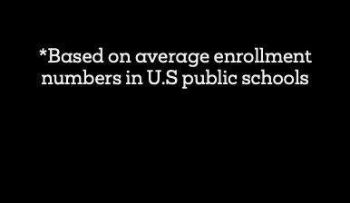
Save The Music Foundation:
25 Year Progress Report
2.5K+
Participating Schools
5M+
Student Reach
$68M
Donated in Instruments & Music Tech Equipment

Slide 22
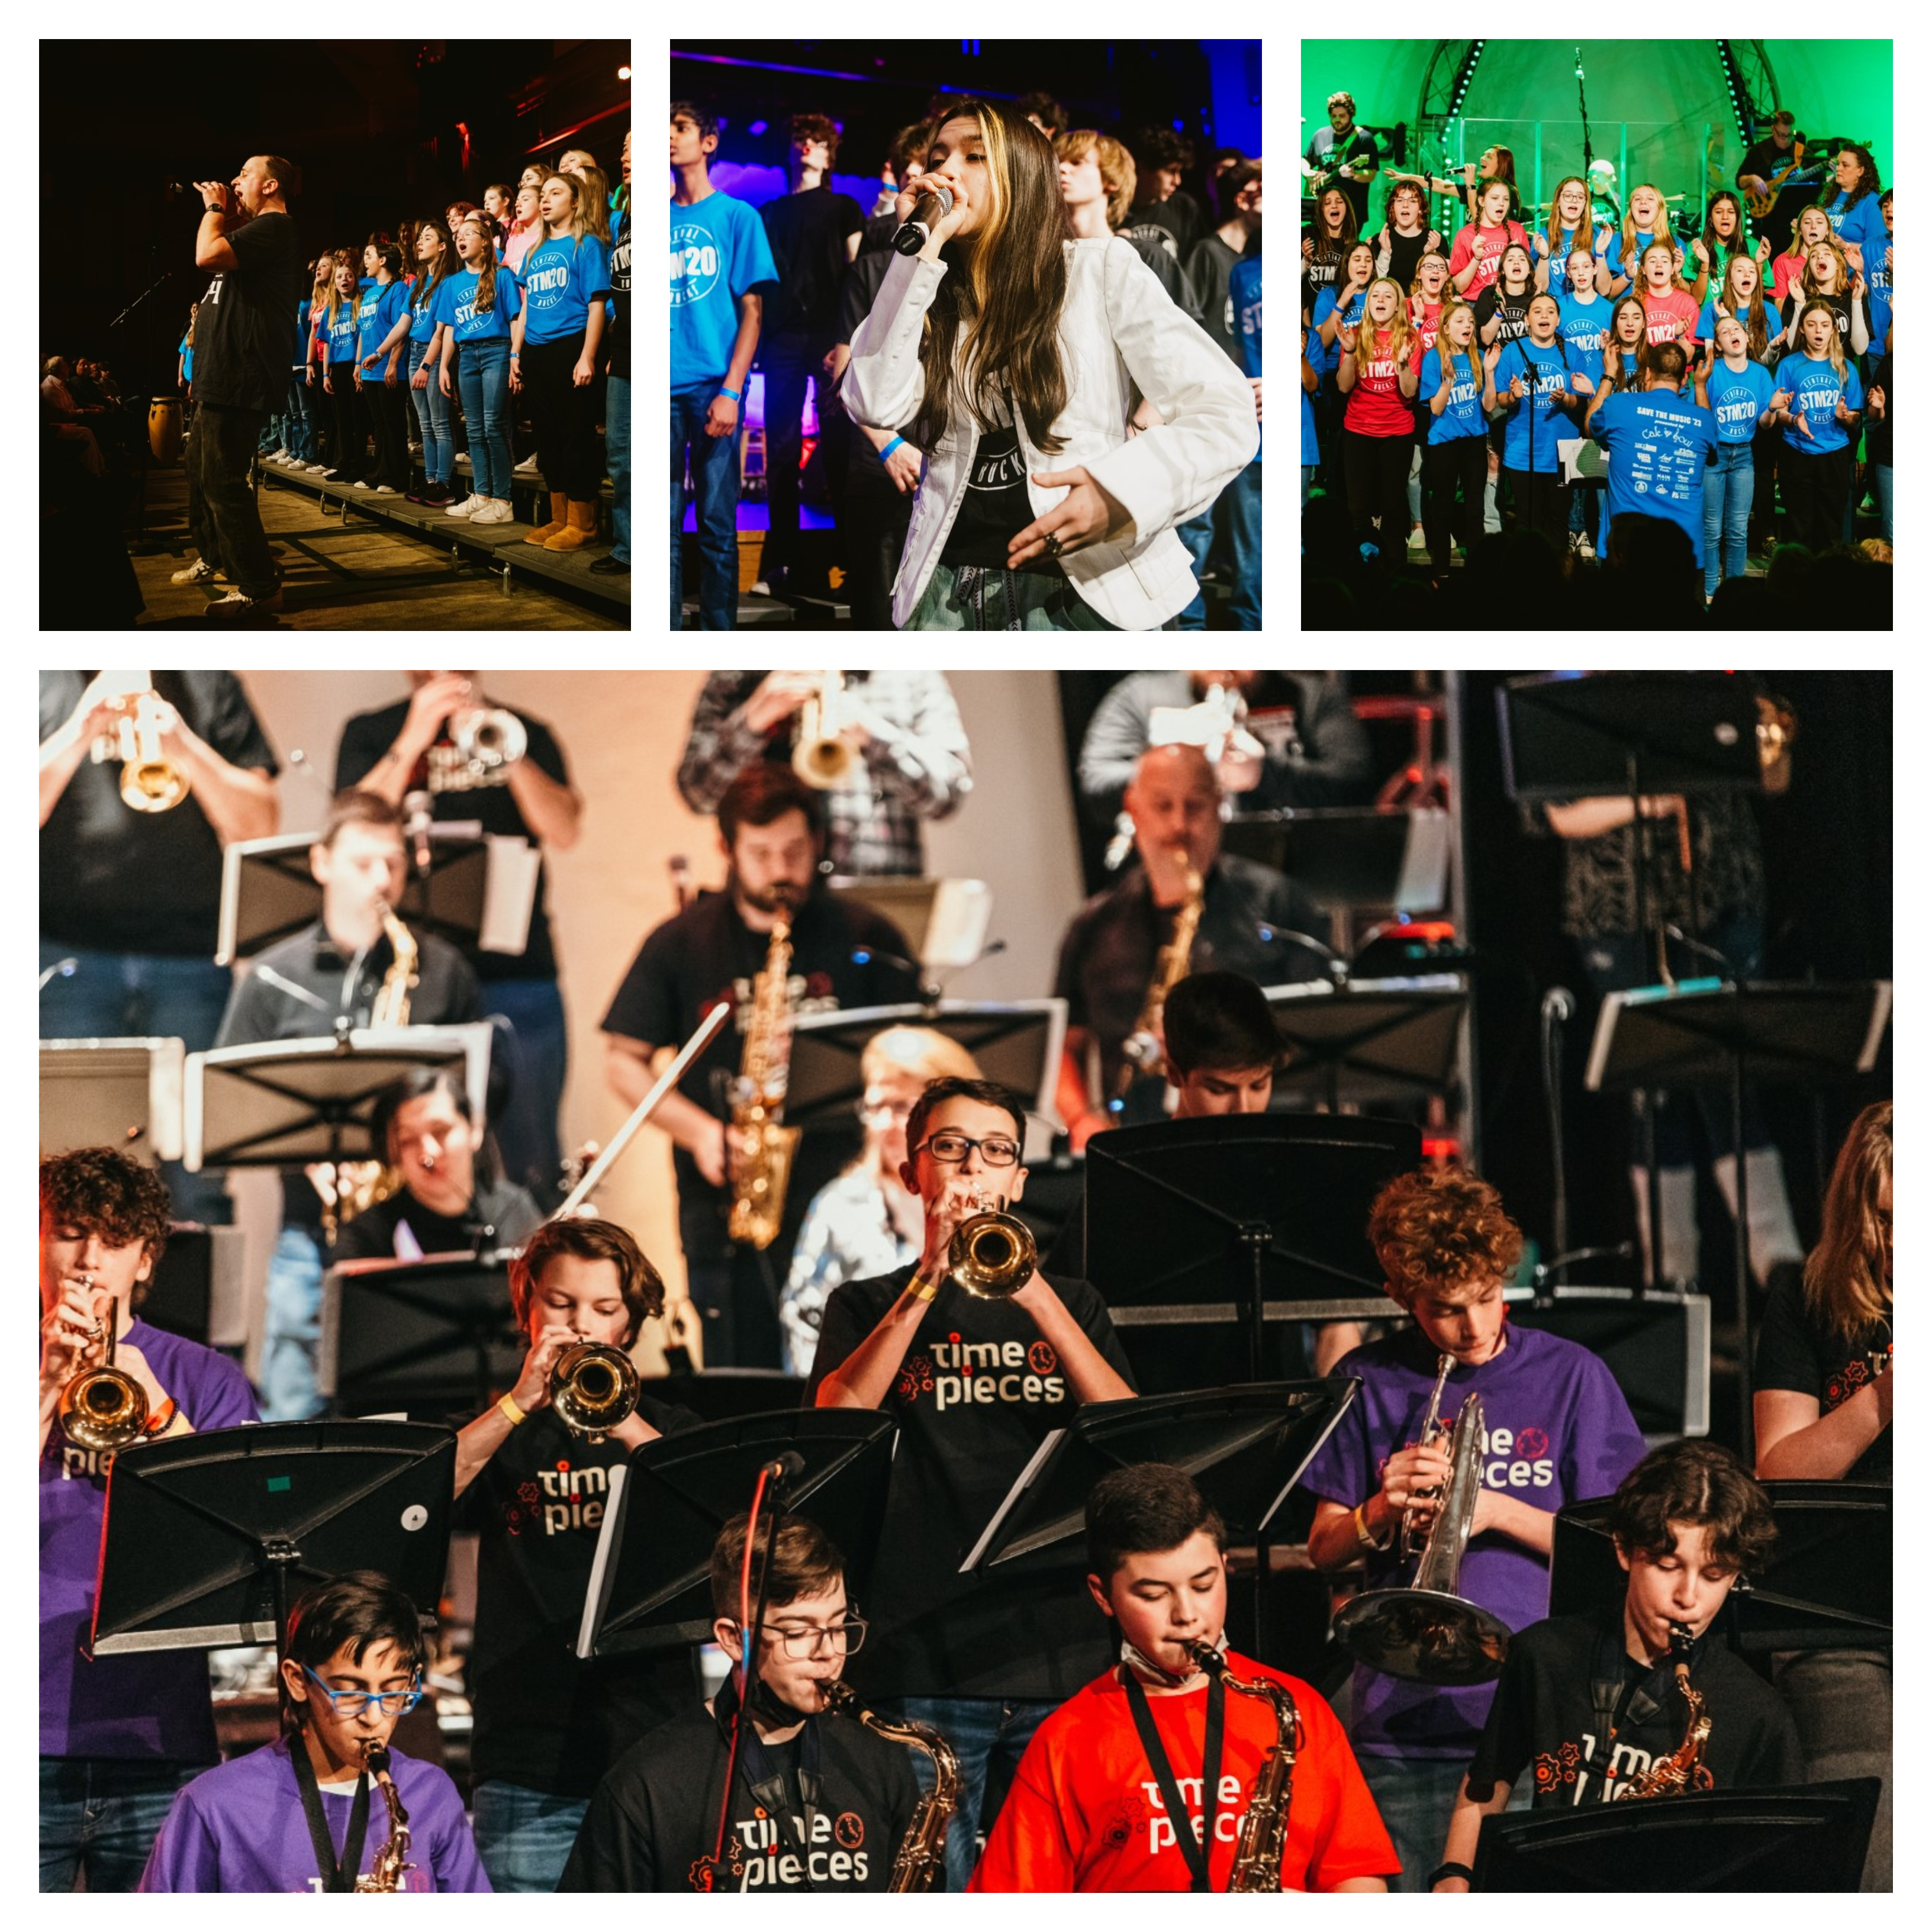
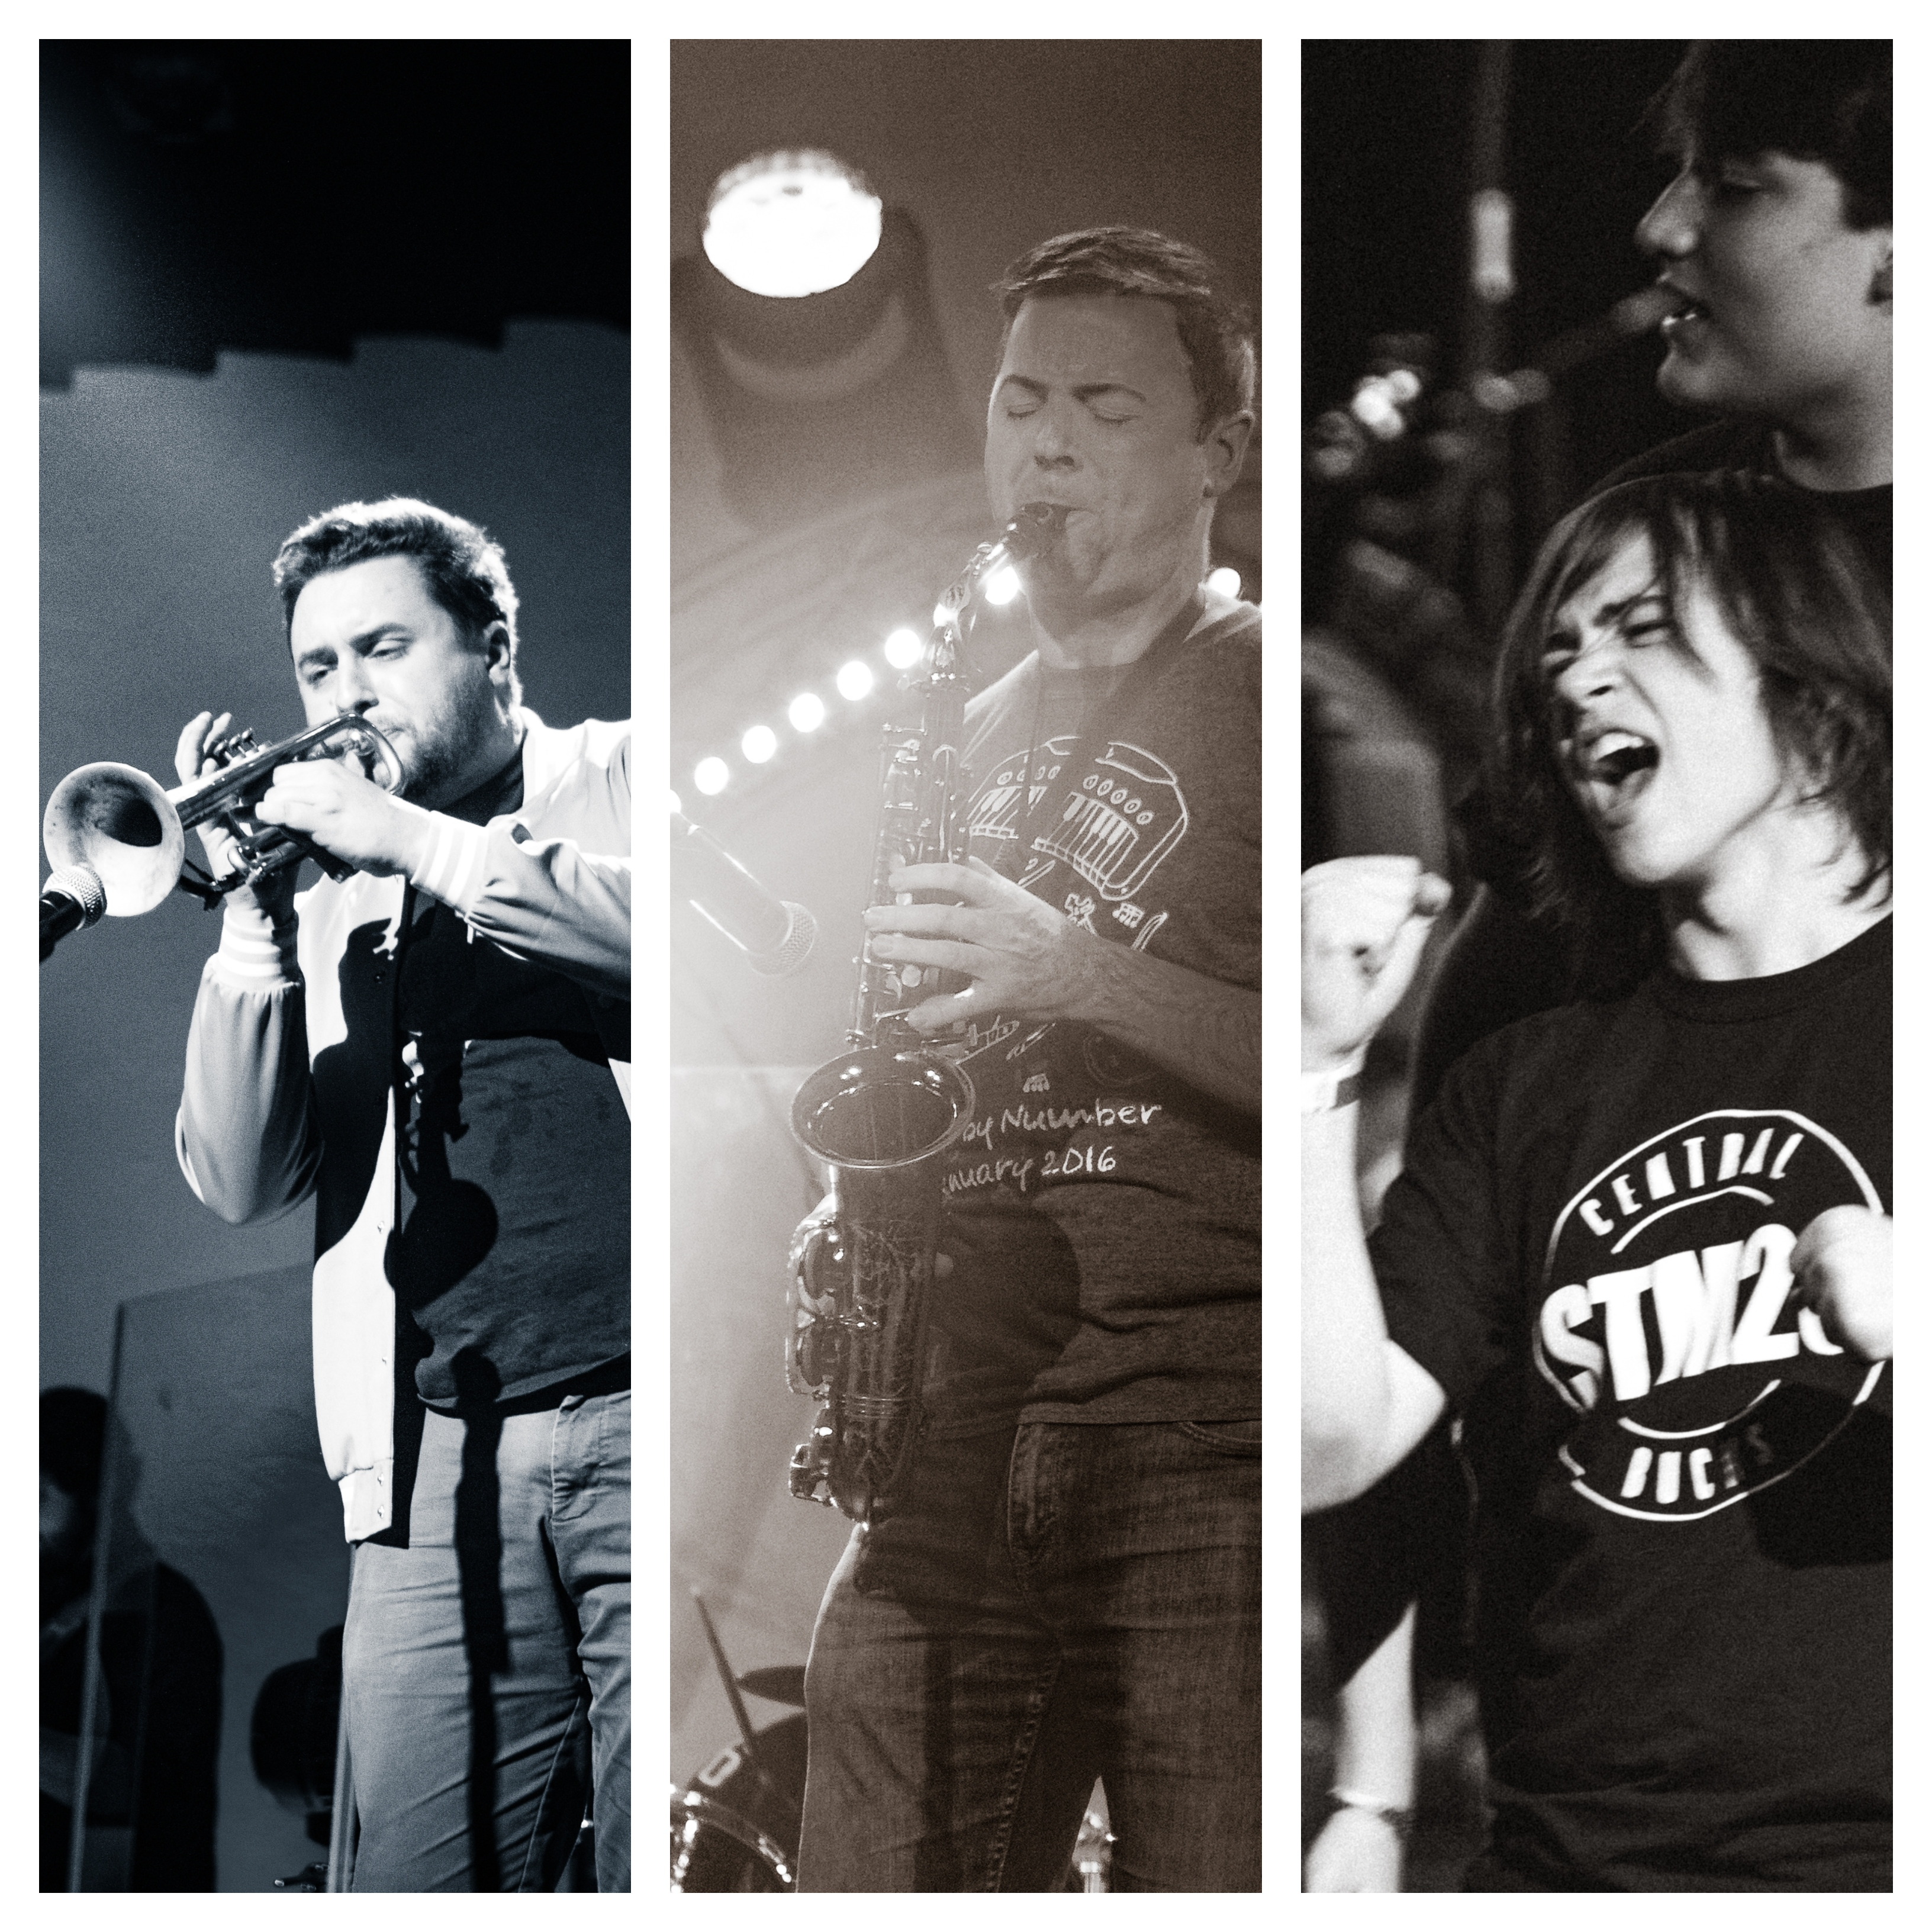

Slide 23
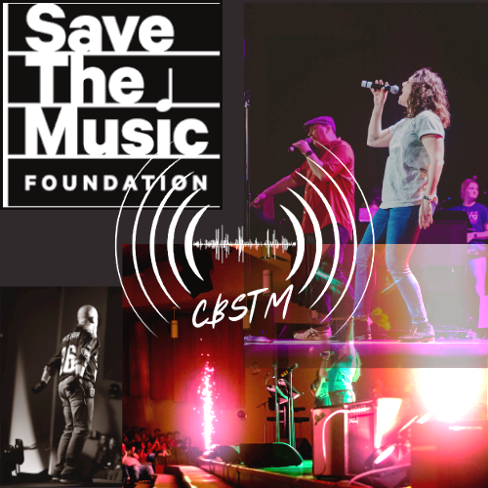
Join The Team!
The CB Save The Music Concert is proud of its continued partnership with the Save The Music Foundation to help fund music education in under-funded areas. Please consider supporting the concert by becoming a CBSTM Sponsor. Every student deserves the chance to have a quality music education, and your sponsorship can help make that a reality.

Slide 24
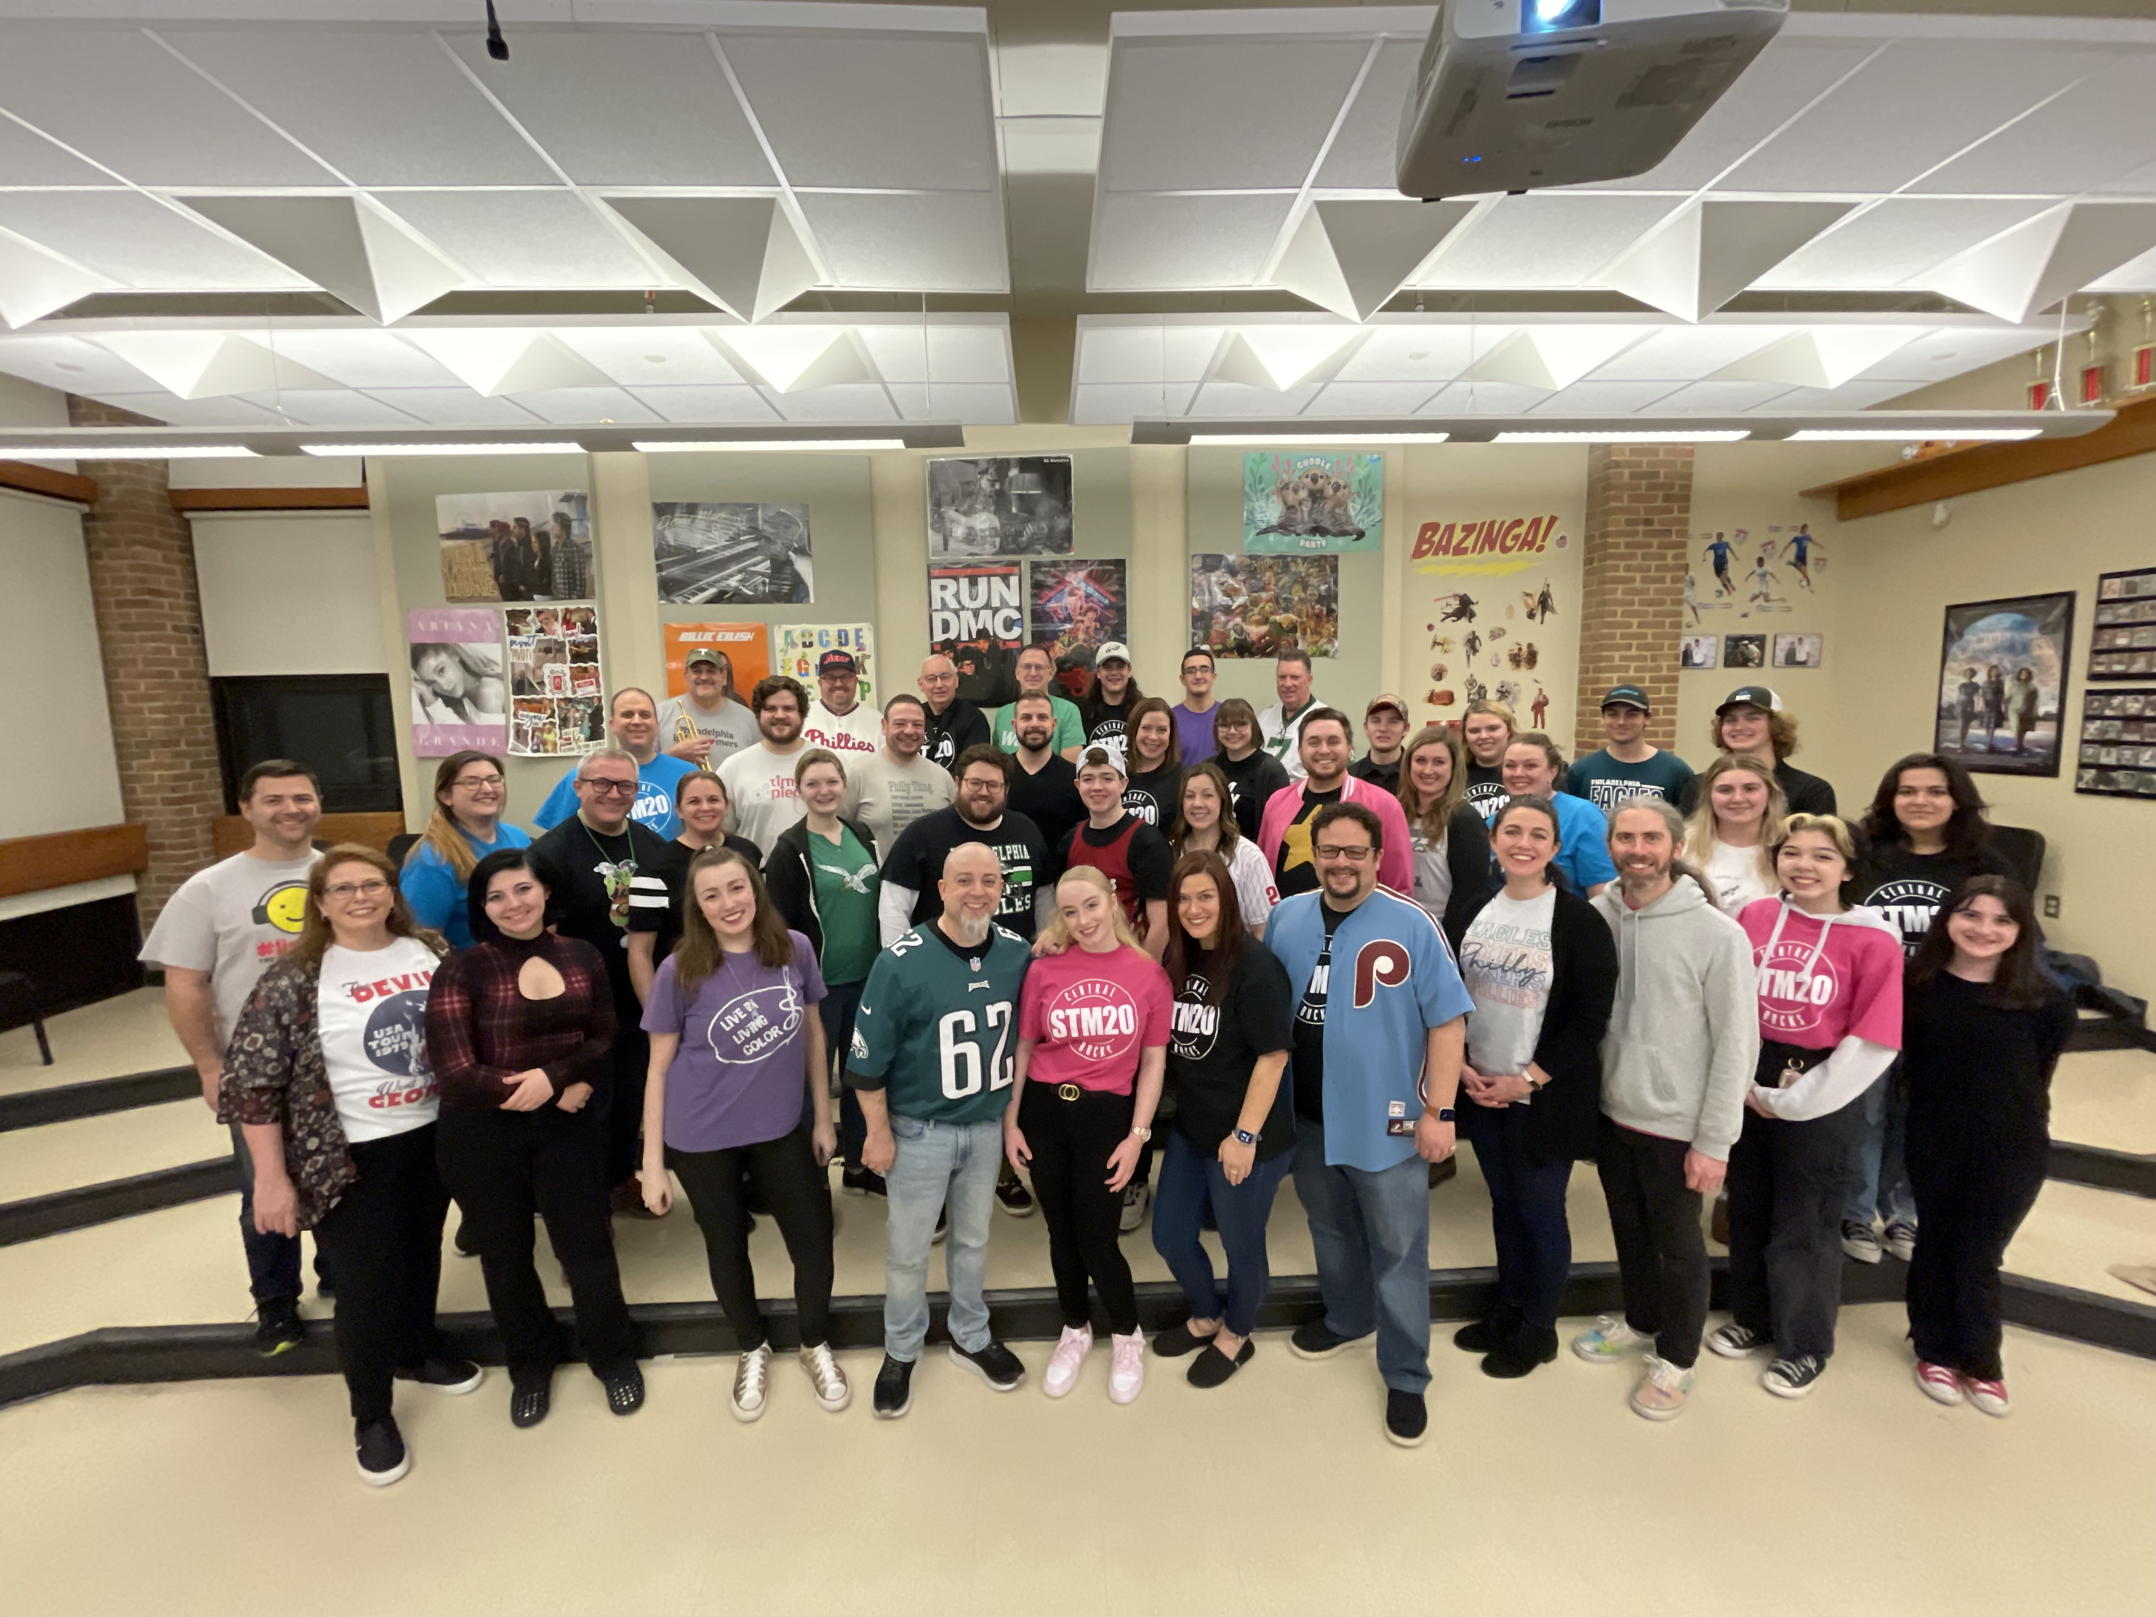
THANK YOU!
Joel Chodoroff on behalf of the CBSTM Concert
Phone:
610-513-1687
Email:
jchodoroff@cbsd.org
Website:
http://www.cbsd.org/stm

